Slide 1
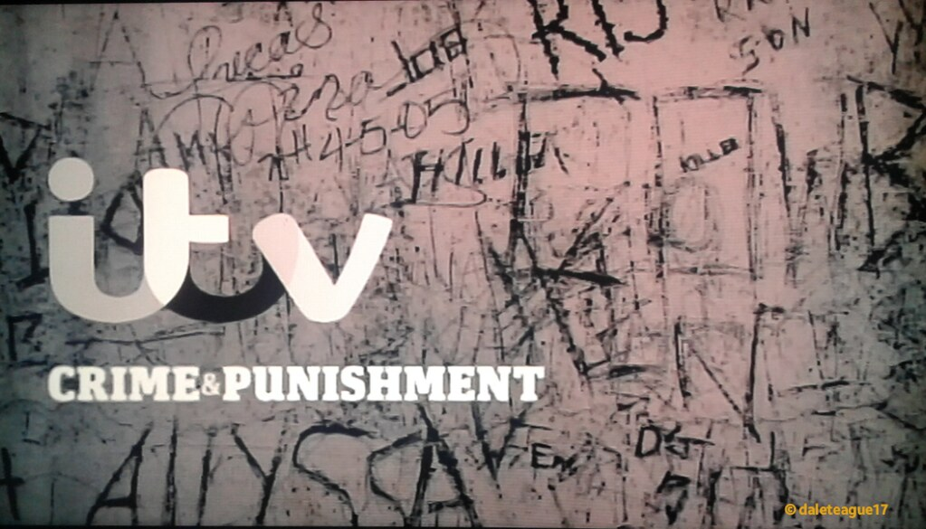
Level 3 Applied Diploma in Criminology
4 Units over 2 years – 2 exams and 2 pieces of controlled assessment Year 1 – Changing Awareness of crime & Criminological theories. Year 2- Crime scene to court room & Crime and punishment
https://www.theguardian.com/uk/ukcrime
https://www.bbc.co.uk/news/topics/cldy2dmy748t/crime
https://www.independent.co.uk/news/uk/crime
24 hours in Police Custody
Channel 4 Crime Season
Murder 24/7
Inside Prison: Britain Behind Bars
Catching Britain’s Killers : The Crimes That Changed Us

Slide 2
Task 1:
In Criminology, we explore Criminological theories (a range of explanations for why crime occurs)
Research the following biological explanations of crime…
For each make notes on:
Key ideas of this explanation
How could this explanation be used to explain crime?
Strengths/weaknesses of this explanation of criminality
1. Frontal Lobe Damage – Phineas Gage
https://www.youtube.com/watch?v=vHrmiy4W9C0
1 min 55 > 5 min 28
2. Sheldon’s Somatotype Theory 3. Lombroso’s Atavistic Features
Task 2: Find the definitions for the following concepts and create a glossary of key terms:
Aggravating factors
Mitigating factors
Suspended sentence
Dark figure of crime
Indictable offence
Recidivism
Deviance
ASBO
Moral panic
Task 3: Watch the following clips and make notes on how a range of evidence is collected and analysed in crime scene investigations.
Fingerprints https://www.youtube.com/watch?v=q1MzUIs-hr4
Footprints https://www.youtube.com/watch?v=7-esqwmLmCs
Hair and fibres https://www.youtube.com/watch?v=BjLHW7qQEl0

